Slide 1
CS Bootcamp
Introduction to Linux and Code Editing

Slide 2
Some quick things
If you have used Linux and worked with it remotely (Ubuntu, Debian, RedHat, etc.) this presentation isn't meant for you.
Please stop me to ask questions.
Use your resources. This will be recorded, and the slides/materials will be publicly posted for your viewing pleasure.
Materials - https://csit.kutztown.edu/UNIXbootcamp/index.html
Student Resources - Maintained by the CSIT Department

Slide 3
Linux
Linux is another type of operating system, just like Windows or MacOS.
Command Line Overview
Linux and Kutztown
The CSIT faculty and students have access to multiple servers
The two main ones: csitrd - (a.k.a. acad, csit, login, unixweb) &
Mcgonagall (a.k.a. Kupapcsit01)

Slide 4
Connecting to CSIT
Windows – Additional Setup Required
Personal Laptop
Follow link to install PuTTY in materials
Profile Setup Walkthrough
Lab Computers
Profiles already setup, open PuTTY and double click "acad no x11"
MacOS / Linux
Just need to use the terminal
ssh username@host
I.e. ssh pearl464@csit.kutztown.edu

Slide 5
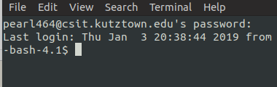
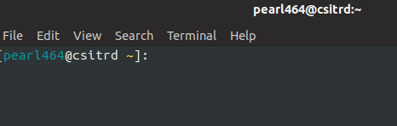
After Login
Scenario One:
Enter these commands
wget http://csit.kutztown.edu/~pearl464/bootcamp/.bashrc
source .bashrc
Your bash should be properly setup now
Scenario Two:
If your prompt looks like this, you're golden :-)

Slide 6
Commands Overview
Some terminology:
Directory (a folder) – Just like your folders in Mac's Finder or Window's File Explorer. Stores multiple files
"~" - Your home directory
Structure of command:
ls [space] -al [space] ~
command [options] [file]

Slide 7
Common Commands
pwd
"Print working directory"
Current directory that your bash prompt is at
ls
"List directory contents"
Shows files and directories within the given directory. Defaults to the current working directory
Common options:
-a – Lists all files and directories (Even hidden if you have permission)
-l – Formats the output as a list
mkdir
Creates a new directory
Example: mkdir ~/csc135
Will make a new directory called "csc135" located in your home

Slide 8
Command Commands (cont.)
rm
Remove file
Options:
-r – Recursive. Used to remove multipe files
-f – Force removal of a file
NOTE: Be careful using the –f option. Once a file is deleted, there is a slim chance it can be recovered.
Example: rm test.txt
man
Provides the manual page for a given command. Very useful if you need to understand how a command works and what the options for it are.

Slide 9
G++
GNU Compiler
Basic format: g++ <filename>
Results in a.out
G++ has many options and flags built in, two important ones are shown below. You can find more information about them and the different flags in the man page.
-o allows you to name your compiled program:
Example: g++ p1.cpp -o p1 will give you an executable called p1
-g to enable debugging
This will keep function/variable names with the executable allowing you to debug your program (Don't worry if you don't know all these terms yet)

Slide 10
File Transfer – Work with files locally
FileZilla Client – MacOS and Windows - https://filezilla-project.org/
https://wiki.filezilla-project.org/FileZilla_Client_Tutorial_(en) Tutorial (For Later Reference)
WinSCP – Windows Only - https://winscp.net/eng/download.php
https://winscp.net/eng/docs/start - Documentation (For Later Reference)

Slide 11
Picking a Text Editor
Pick the right tool for your job
Make things better for yourself:
***Learn keyboard shortcuts***
Plugins
Themes
Make your editor part of your workflow
Shortcuts speed things up
Command Line vs GUI

Slide 12
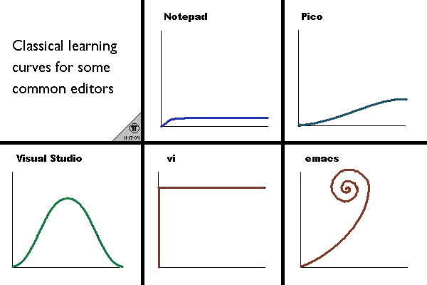
Text Editing – Command Line
emacs
vim
Quick and fast
Editor
Exiting: <ESC> :q
Most of the faculty use it
Flexible and powerful – An IDE
Exiting: Cntl-X Cntl-C
More Resources:
Emacs Guide Tutorial:
https://www.gnu.org/software/emacs/tour/
Interactive Vim Tutorial: https://www.openvim.com/
Image Source: https://unix.stackexchange.com/questions/986/what-are-the-pros-and-cons-of-vim-and-emacs/988#988

Slide 13
Handy Keyboard Shortcuts
Select next instance of word (multi-cursor):
Sublime, VSCode: CTRL+D
Duplicate Line:
Sublime: CTRL+Shift+D
VSCode: Shift+Alt+Down or Shift+Alt+Up
Notepad++: CTRL+D
Emacs: C-a C-SPACE C-n M-w C-y
Emacs Commands:
C (short for CTRL)
M (short for Meta, either Alt or ESC)
C-a – move cursor to start of line
C-Space – sets a mark to begin selection ("start highlighting")
C-n – move cursor to next line
M-w - copy highlighted region
C-y – paste (stands for "yank")
C-k – cut ("kill") the rest of the line
The point is to learn ways of speeding up repetitive tasks!

Slide 14
Notepad++
Pros
Cons
Free forever
Fast/lightweight
FTP Capabilities
No Git support
Windows only
Bad plugin support
Dated UI

Slide 15
VSCode
Pros
Cons
Free/Open Source
Great plugin options
Built-in terminal
Git support
Modern and customizable UI
Windows, macOS, Linux
No default FTP (3rd party plugins available)
Built on Electron, a RAM hog

